Slide 1

Final Presentation
Simon Gourdon, Alex Bouchentouf, Avdusinovic Sadin
Software Engineering Project
Uni.lu

Slide 2


Table of content
Achieved since THE 2ND sPRINT
Gameplay
1 Semester
2 Semester
Quiz
Commercial video

Slide 3
Achieved since THE 2ND sPRINT
2nd Semester
Different courses
Different bubble floating
Quiz
Changed to one quiz only
Commercial Video
Documentation

Slide 4
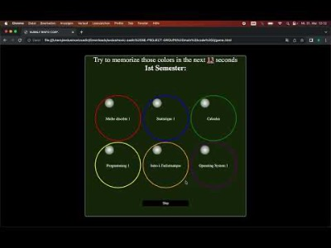
Gameplay

Slide 5

Commercial video

Slide 6

Thanks For your attention

